Slide 1
Deep learning
Hung-Hsuan Chen

Slide 2
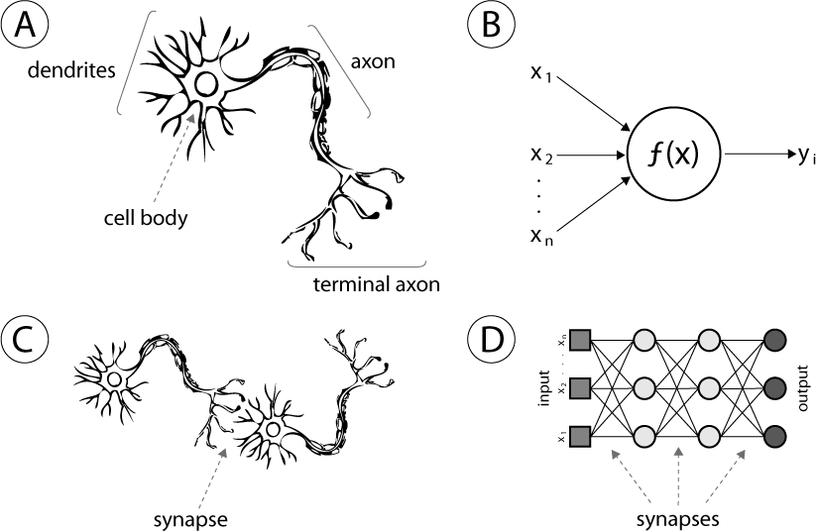
Biological neural network vs artificial neural network (ANN)
A synapse is a structure that permits a neuron to pass an electrical or chemical signal to another neuron.
A: human neuron
B: artificial neuron
C: biological synapse
D: ANN synapse

Slide 3
Simple ANN vs deep learning
Simple neural network is also called single layer neural network
Single layer ➔ single hidden layer

Slide 4
Why deep learning?

Slide 5
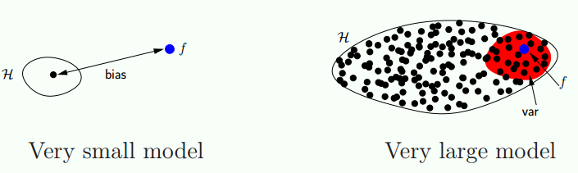
Deep learning and big data
Small model: tend to have high bias
Deep learning (large model) and small data: tend to have high variance
Deep learning (large model) and big data: small bias and small variance
Computation cost is an issue

Slide 6
Learning representations
Deep learning is part of a broader family of machine learning methods based on learning data representations
E.g., in CV, traditionally handcraft features (e.g., SIFT, HOG, etc.) are used as the features, but in deep learning, “raw pixels” are used as the features

Slide 7
An example of learning data representation

Slide 8
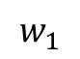
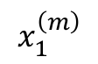
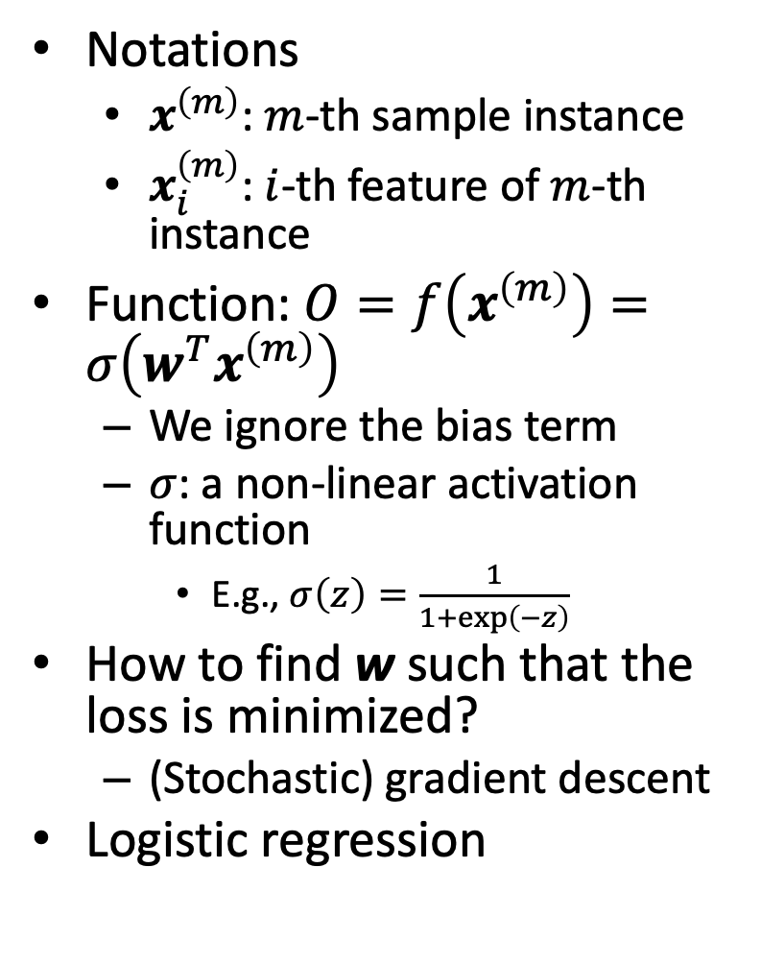
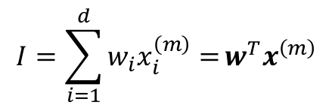
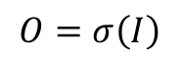
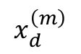
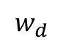
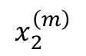
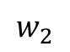
Computation of a neuron
Notations
$x^{\left(m\right)}$: $m$-th sample instance
$x_{i}^{\left(m\right)}$: $i$-th feature of $m$-th instance
Function: $O=f\left(x^{\left(m\right)}\right)=σ\left(w^{T}x^{\left(m\right)}\right)$
We ignore the bias term
$σ$: a non-linear activation function
E.g., $σ\left(z\right)=\frac{1}{1+\exp\left(−z\right)}$
How to find w such that the loss is minimized?
(Stochastic) gradient descent
Logistic regression
$$O=σ\left(I\right)$$
$$I=\sum_{i=1}^{d}{w_{i}x_{i}^{\left(m\right)}=}w^{T}x^{\left(m\right)}$$
$$w_{1}$$
$$w_{2}$$
$$w_{d}$$
$$x_{1}^{\left(m\right)}$$
$$x_{2}^{\left(m\right)}$$
...
$$x_{d}^{\left(m\right)}$$

Slide 9
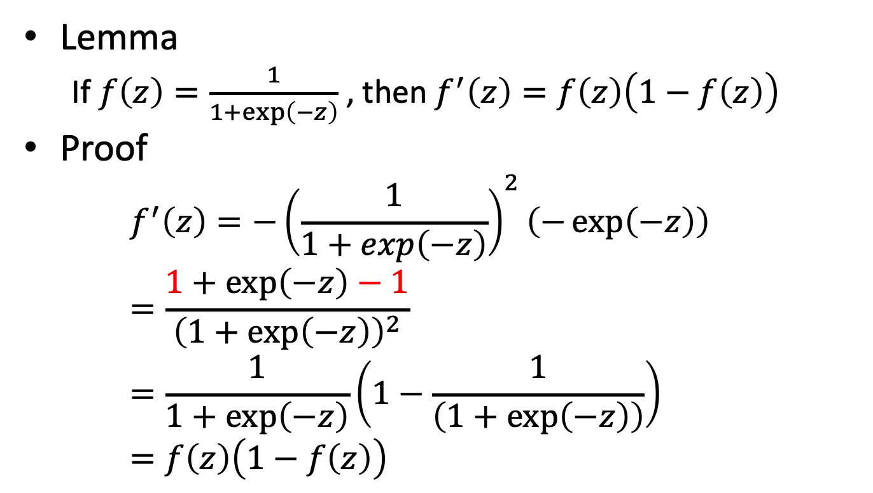
Review: gradient of the logistic function
Lemma
If $f\left(z\right)=\frac{1}{1+\exp\left(−z\right)}$ , then $f^{′}\left(z\right)=f\left(z\right)\left(1−f\left(z\right)\right)$
Proof
$$f^{′}\left(z\right)=−{\left(\frac{1}{1+\exp\left(−z\right)}\right)}^{2}\left(−\exp\left(−z\right)\right)=\frac{1+\exp\left(−z\right)−1}{{\left(1+\exp\left(−z\right)\right)}^{2}}=\frac{1}{1+\exp\left(−z\right)}\left(1−\frac{1}{\left(1+\exp\left(−z\right)\right)}\right)=f\left(z\right)\left(1−f\left(z\right)\right)$$

Slide 10
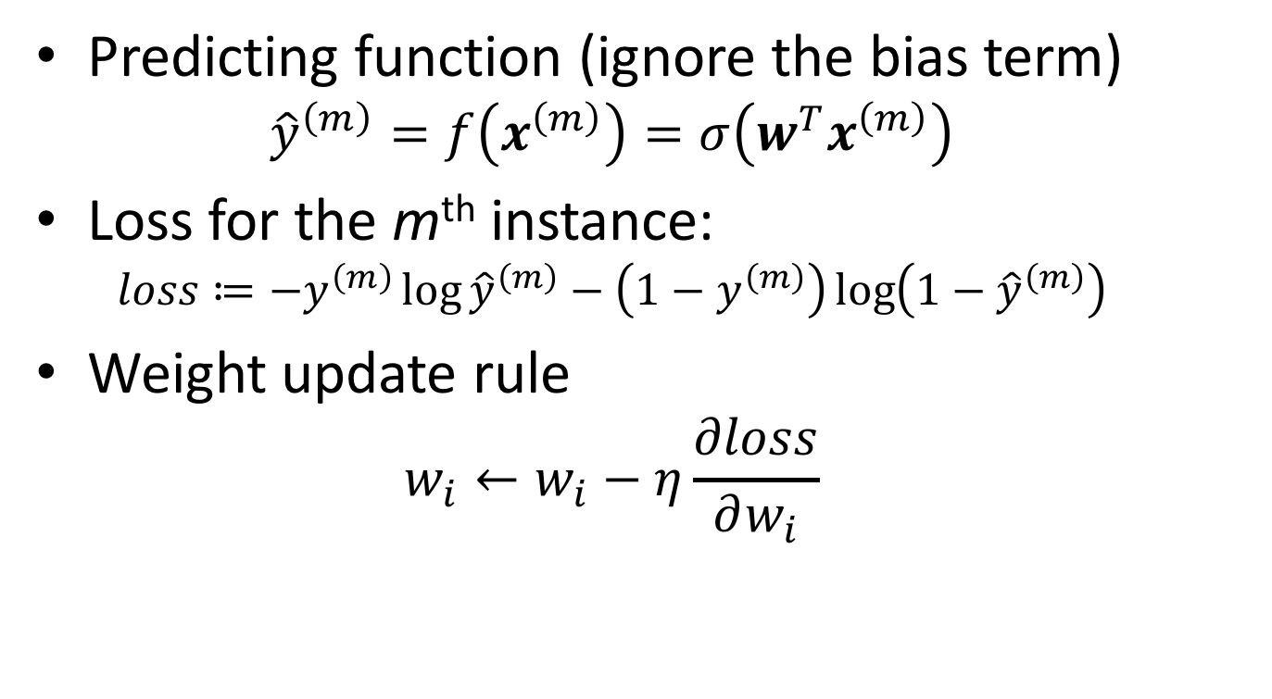
Review: logistic regression model training (by SGD)
Predicting function (ignore the bias term)
$${\hat{y}}^{\left(m\right)}=f\left(x^{\left(m\right)}\right)=σ\left(w^{T}x^{\left(m\right)}\right)$$
Loss for the m^{th} instance:
$$loss≔−y^{\left(m\right)}\log{{\hat{y}}^{\left(m\right)}}−\left(1−y^{\left(m\right)}\right)\log\left(1−{\hat{y}}^{\left(m\right)}\right)$$
Weight update rule
$$w_{i}←w_{i}−η\frac{∂loss}{∂w_{i}}$$

Slide 11
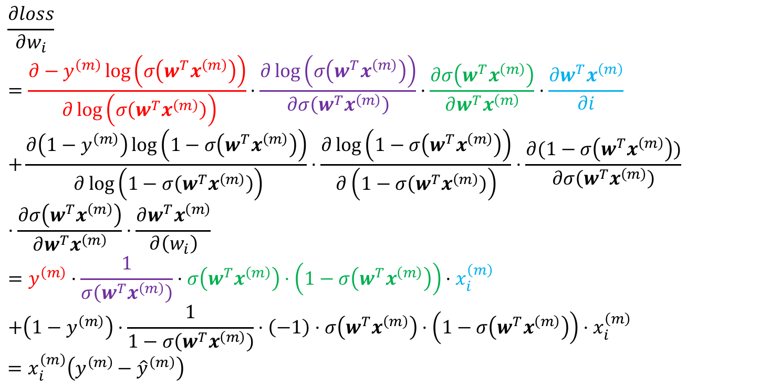
Review: gradient of logistic regression
$$\frac{∂loss}{∂w_{i}} \\ =\frac{∂−y^{\left(m\right)}\log\left(σ\left(w^{T}x^{\left(m\right)}\right)\right)}{ ∂\log\left(σ\left(w^{T}x^{\left(m\right)}\right)\right)}⋅\frac{∂\log\left(σ\left(w^{T}x^{\left(m\right)}\right)\right)}{∂σ\left(w^{T}x^{\left(m\right)}\right)}⋅\frac{∂σ\left(w^{T}x^{\left(m\right)}\right)}{∂w^{T}x^{\left(m\right)}}⋅\frac{∂w^{T}x^{\left(m\right)}}{∂i} \\ +\frac{∂\left(1−y^{\left(m\right)}\right)\log\left(1−σ\left(w^{T}x^{\left(m\right)}\right)\right)}{ ∂\log\left(1−σ\left(w^{T}x^{\left(m\right)}\right)\right)}⋅\frac{∂\log\left(1−σ\left(w^{T}x^{\left(m\right)}\right)\right)}{∂\left(1−σ\left(w^{T}x^{\left(m\right)}\right)\right)}⋅\frac{∂(1−σ\left(w^{T}x^{\left(m\right)}\right))}{∂σ\left(w^{T}x^{\left(m\right)}\right)}⋅\frac{∂σ\left(w^{T}x^{\left(m\right)}\right)}{∂w^{T}x^{\left(m\right)}}⋅\frac{∂w^{T}x^{\left(m\right)}}{∂\left(w_{i}\right)} \\ =y^{\left(m\right)}⋅\frac{1}{σ\left(w^{T}x^{\left(m\right)}\right)}⋅σ\left(w^{T}x^{\left(m\right)}\right)⋅\left(1−σ\left(w^{T}x^{\left(m\right)}\right)\right)⋅x_{i}^{\left(m\right)} \\ +\left(1−y^{\left(m\right)}\right)⋅\frac{1}{1−σ\left(w^{T}x^{\left(m\right)}\right)}⋅\left(−1\right)⋅σ\left(w^{T}x^{\left(m\right)}\right)⋅\left(1−σ\left(w^{T}x^{\left(m\right)}\right)\right)⋅x_{i}^{\left(m\right)} \\ =x_{i}^{\left(m\right)}\left(y^{\left(m\right)}−{\hat{y}}^{\left(m\right)}\right)$$

Slide 12
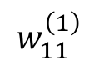
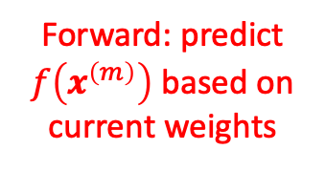
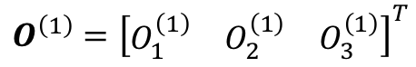
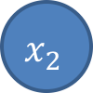
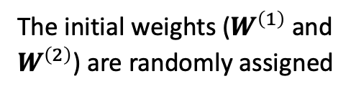
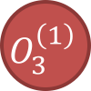
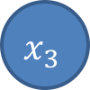
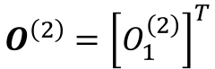

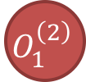

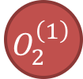
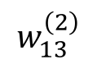
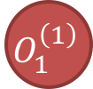
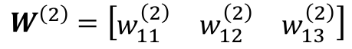
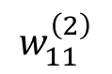
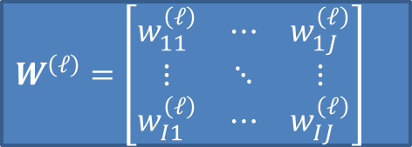
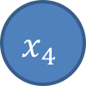
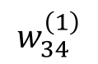
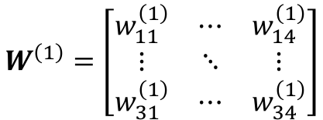
Feedforward neural network
Forward: predict $f\left(x^{\left(m\right)}\right)$ based on current weights
$$O^{\left(ℓ\right)}={\left[\begin{matrix}O_{1}^{\left(ℓ\right)} & … & O_{I}^{\left(ℓ\right)}\end{matrix}\right]}^{T}$$
Back-prop: adjust weights to minimize error
$$W^{\left(ℓ\right)}=\left[\begin{matrix}w_{11}^{\left(ℓ\right)} & ⋯ & w_{1J}^{\left(ℓ\right)} \\ ⋮ & ⋱ & ⋮ \\ w_{I1}^{\left(ℓ\right)} & ⋯ & w_{IJ}^{\left(ℓ\right)}\end{matrix}\right]$$
$$O_{1}^{\left(2\right)}$$
$$O^{\left(2\right)}={\left[O_{1}^{\left(2\right)}\right]}^{T}$$
$$w_{11}^{\left(2\right)}$$
$$w_{13}^{\left(2\right)}$$
$$W^{\left(2\right)}=\left[\begin{matrix}w_{11}^{\left(2\right)} & w_{12}^{\left(2\right)} & w_{13}^{\left(2\right)}\end{matrix}\right]$$
$$O_{1}^{\left(1\right)}$$
$$O_{2}^{\left(1\right)}$$
$$O_{3}^{\left(1\right)}$$
$$O^{\left(1\right)}={\left[\begin{matrix}O_{1}^{\left(1\right)} & O_{2}^{\left(1\right)} & O_{3}^{\left(1\right)}\end{matrix}\right]}^{T}$$
$$w_{11}^{\left(1\right)}$$
$$w_{34}^{\left(1\right)}$$
$$W^{\left(1\right)}=\left[\begin{matrix}w_{11}^{\left(1\right)} & ⋯ & w_{14}^{\left(1\right)} \\ ⋮ & ⋱ & ⋮ \\ w_{31}^{\left(1\right)} & ⋯ & w_{34}^{\left(1\right)}\end{matrix}\right]$$
$$x_{1}$$
$$x_{2}$$
$$x_{3}$$
$$x_{4}$$
The initial weights ($W^{\left(1\right)}$ and $W^{\left(2\right)}$) are randomly assigned

Slide 13

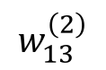
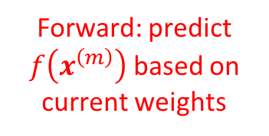

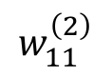
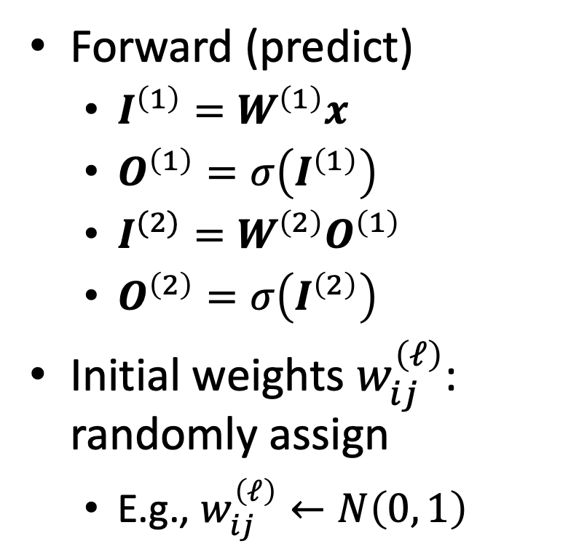

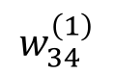
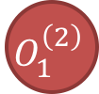
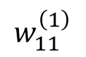

Forward (predict)
Forward: predict $f\left(x^{\left(m\right)}\right)$ based on current weights
Forward (predict)
$I^{\left(1\right)}=W^{\left(1\right)}x$
$O^{\left(1\right)}=σ\left(I^{\left(1\right)}\right)$
$I^{(2)}=W^{\left(2\right)}O^{\left(1\right)}$
$O^{\left(2\right)}=σ\left(I^{\left(2\right)}\right)$
Initial weights $w_{ij}^{\left(ℓ\right)}$: randomly assign
E.g., $w_{ij}^{\left(ℓ\right)}←N\left(0, 1\right)$
$$O_{1}^{\left(2\right)}$$
$$w_{11}^{\left(2\right)}$$
$$w_{13}^{\left(2\right)}$$
$$O_{1}^{\left(1\right)}$$
$$O_{2}^{\left(1\right)}$$
$$O_{3}^{\left(1\right)}$$
$$w_{11}^{\left(1\right)}$$
$$w_{34}^{\left(1\right)}$$
$$x_{1}$$
$$x_{2}$$
$$x_{3}$$
$$x_{4}$$

Slide 14

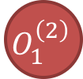
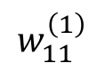

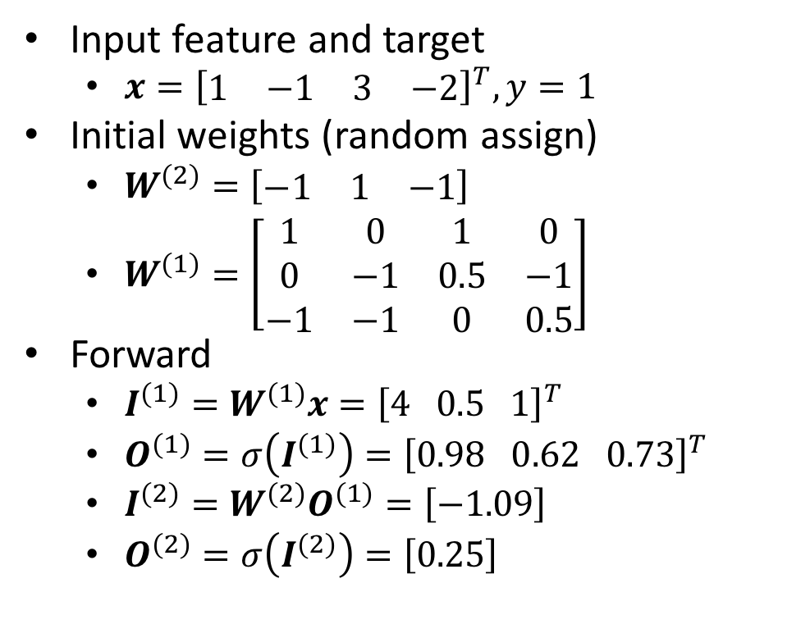
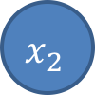
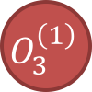
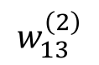
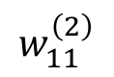
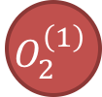
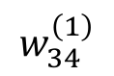
Forward example
Input feature and target
$x={\left[\begin{matrix}1 & −1 & 3 & −2\end{matrix}\right]}^{T}, y=1$
Initial weights (random assign)
$W^{\left(2\right)}=\left[\begin{matrix}−1 & 1 & −1\end{matrix}\right]$
$W^{\left(1\right)}=\left[\begin{matrix}1 & 0 & 1 & 0 \\ 0 & −1 & 0.5 & −1 \\ −1 & −1 & 0 & 0.5\end{matrix}\right]$
Forward
$I^{\left(1\right)}=W^{\left(1\right)}x={\left[4 0.5 1\right]}^{T}$
$O^{\left(1\right)}=σ\left(I^{\left(1\right)}\right)={\left[0.98 0.62 0.73\right]}^{T}$
$I^{\left(2\right)}=W^{\left(2\right)}O^{\left(1\right)}=\left[−1.09\right]$
$O^{\left(2\right)}=σ\left(I^{\left(2\right)}\right)=\left[0.25\right]$
$$O_{1}^{\left(2\right)}$$
$$w_{11}^{\left(2\right)}$$
$$w_{13}^{\left(2\right)}$$
$$O_{1}^{\left(1\right)}$$
$$O_{2}^{\left(1\right)}$$
$$O_{3}^{\left(1\right)}$$
$$w_{11}^{\left(1\right)}$$
$$w_{34}^{\left(1\right)}$$
$$x_{1}$$
$$x_{2}$$
$$x_{3}$$
$$x_{4}$$

Slide 15
Back-propagation
Some slides are taken from Prof. Fei-Fei Li

Slide 16
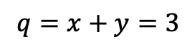
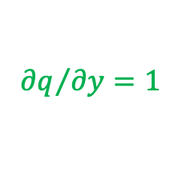













Computational graph
$f\left(x,y,z\right)=\left(x+y\right)z$
E.g., $x=−2, y=5, z=−4$
$$x:−2$$
$$q=x+y=3$$
$$f=q∗z=−12$$
$${∂q}/{∂x}=1$$
$$+$$
$$∗$$
$${∂f}/{∂q}=z=−4$$
$$y:5$$
$$\frac{∂f}{∂x}=\frac{∂f}{∂q}×\frac{∂q}{∂x}=\left(−4\right)×1=−4$$
$${∂q}/{∂y}=1$$
$${∂f}/{∂z}=q=3$$
$$\frac{∂f}{∂y}=\frac{∂f}{∂q}×\frac{∂q}{∂y}=\left(−4\right)×1=−4$$
$$z:−4$$
$$\frac{∂f}{∂z}=3$$

Slide 17

Local gradient and chain rule
Given $f\left(x,y\right)=z$ and the global loss is $L$
Compute local gradients $\frac{∂z}{∂x}$ and $\frac{∂z}{∂y}$
The value of $\frac{∂L}{∂z}$ is computed by other components in the computational graph
Based on chain rule, we can get $\frac{∂L}{∂x}$ and $\frac{∂L}{∂y}$ by $\frac{∂L}{∂x}=\frac{∂L}{∂z}×\frac{∂z}{∂x}$, and $\frac{∂L}{∂y}=\frac{∂L}{∂z}×\frac{∂z}{∂y}$

Slide 18
















Compute local gradient for every operator and apply chain rule
$$f_{0}$$
$$x$$
$$f$$
$$z$$
$$f_{1}$$
$$y$$
Local gradient $\frac{∂z}{∂x}$
$$f_{0}$$
$$x$$
$$f$$
$$\frac{∂L}{∂x}=\frac{∂L}{∂z}×\frac{∂z}{∂x}$$
$$z$$
$$y$$
$$\frac{∂L}{∂z}$$
$$f_{1}$$
$$\frac{∂L}{∂y}=\frac{∂L}{∂z}×\frac{∂z}{∂y}$$
Local gradient $\frac{∂z}{∂y}$

Slide 19


































Example: logistic function
$$f\left(w,x\right)=\frac{1}{1+e^{−\left(w_{0}+w_{1}x_{1}+w_{2}x_{2}\right)}}$$
Observing $\left(x_{1},x_{2},y\right)=\left(−1, −2, 1\right)$
$$w_{0}:−3$$
$$g_{3}$$
$$g_{1}$$
$$−2$$
$$+$$
$$−5$$
$$g_{4}$$
$$g_{5}$$
$$g_{6}$$
$$g_{7}$$
$$g_{8}$$
$$w_{1}:2$$
$$∗$$
$$1$$
$$−1$$
$$0.37$$
$$1.37$$
$$0.73$$
$$+$$
$$∗\left(−1\right)$$
$$exp$$
$$+1$$
$$\frac{1}{x}$$
$$L$$
$$0.315$$
$$x_{1}:−1$$
$$g_{2}$$
$$6$$
$$w_{2}:−3$$
By cross entropy loss (here $\hat{y}=g_{8}$):
$$L\left(y,g_{8}\right)=−y\log{g_{8}}−\left(1−y\right)\log\left(1−g_{8}\right)=0.315$$
$$∗$$
$$x_{2}:−2$$

Slide 20



Example: logistic function
$$f\left(w,x\right)=\frac{1}{1+e^{−\left(w_{0}+w_{1}x_{1}+w_{2}x_{2}\right)}}$$
Observing $\left(x_{1},x_{2},y\right)=\left(−1, −2, 1\right)$
$$w_{0}:−3$$
$$g_{3}$$
$$g_{1}$$
$$−2$$
$$+$$
$$−5$$
$$g_{4}$$
$$g_{5}$$
$$g_{6}$$
$$g_{7}$$
$$g_{8}$$
$$w_{1}:2$$
$$∗$$
$$1$$
$$−1$$
$$0.37$$
$$1.37$$
$$0.73$$
$$0.315$$
$$+$$
$$∗\left(−1\right)$$
$$exp$$
$$+1$$
$$\frac{1}{x}$$
$$L$$
$$x_{1}:−1$$
$$−1.37$$
$$g_{2}$$
$$6$$
$$w_{2}:−3$$
$$L\left(y,g_{8}\right)=−y\log{g_{8}}−\left(1−y\right)\log\left(1−g_{8}\right)$$
$$⇒\frac{∂L}{∂g_{8}}=−\frac{y}{g_{8}}+\frac{1−y}{1−g_{8}}$$
$${\left.\frac{∂L}{∂g_{8}}\right|}_{g_{8}=0.73}=−\frac{1}{0.73}=−1.37$$
$$∗$$
$$x_{2}:−2$$

Slide 21



Example: logistic function
$$f\left(w,x\right)=\frac{1}{1+e^{−\left(w_{0}+w_{1}x_{1}+w_{2}x_{2}\right)}}$$
Observing $\left(x_{1},x_{2},y\right)=\left(−1, −2, 1\right)$
$$w_{0}:−3$$
$$g_{3}$$
$$g_{1}$$
$$−2$$
$$+$$
$$−5$$
$$g_{4}$$
$$g_{5}$$
$$g_{6}$$
$$g_{7}$$
$$g_{8}$$
$$w_{1}:2$$
$$∗$$
$$1$$
$$−1$$
$$0.37$$
$$1.37$$
$$0.73$$
$$0.315$$
$$+$$
$$∗\left(−1\right)$$
$$exp$$
$$+1$$
$$\frac{1}{x}$$
$$L$$
$$x_{1}:−1$$
$$0.73$$
$$−1.37$$
$$g_{2}$$
$$6$$
$$w_{2}:−3$$
$$g_{8}\left(g_{7}\right)=\frac{1}{g_{7}}$$
$$⇒\frac{∂g_{8}}{∂g_{7}}=−\frac{1}{g_{7}^{2}}$$
$${\left.\frac{∂g_{8}}{∂g_{7}}\right|}_{g_{7}=1.37}=−\frac{1}{{1.37}^{2}}=−0.53$$
$$\frac{∂L}{∂g_{7}}=\frac{∂L}{∂g_{8}}×\frac{∂g_{8}}{∂g_{7}}=−1.37×−0.53=0.73$$
$$∗$$
$$x_{2}:−2$$

Slide 22


Example: logistic function
$$f\left(w,x\right)=\frac{1}{1+e^{−\left(w_{0}+w_{1}x_{1}+w_{2}x_{2}\right)}}$$
Observing $\left(x_{1},x_{2},y\right)=\left(−1, −2, 1\right)$
$$w_{0}:−3$$
$$g_{3}$$
$$g_{1}$$
$$−2$$
$$+$$
$$−5$$
$$g_{4}$$
$$g_{5}$$
$$g_{6}$$
$$g_{7}$$
$$g_{8}$$
$$w_{1}:2$$
$$∗$$
$$1$$
$$−1$$
$$0.37$$
$$1.37$$
$$0.73$$
$$0.315$$
$$+$$
$$∗\left(−1\right)$$
$$exp$$
$$+1$$
$$\frac{1}{x}$$
$$L$$
$$x_{1}:−1$$
$$0.73$$
$$0.73$$
$$−1.37$$
$$g_{2}$$
$$6$$
$$w_{2}:−3$$
$$g_{7}\left(g_{6}\right)=g_{6}+1$$
$$⇒\frac{∂g_{7}}{∂g_{6}}=1$$
$${\left.\frac{∂g_{7}}{∂g_{6}}\right|}_{g_{6}=0.37}=1$$
$$\frac{∂L}{∂g_{6}}=\frac{∂L}{∂g_{7}}×\frac{∂g_{7}}{∂g_{6}}=0.73×1=0.73$$
$$∗$$
$$x_{2}:−2$$

Slide 23


Example: logistic function
$$f\left(w,x\right)=\frac{1}{1+e^{−\left(w_{0}+w_{1}x_{1}+w_{2}x_{2}\right)}}$$
Observing $\left(x_{1},x_{2},y\right)=\left(−1, −2, 1\right)$
$$w_{0}:−3$$
$$g_{3}$$
$$g_{1}$$
$$−2$$
$$+$$
$$−5$$
$$g_{4}$$
$$g_{5}$$
$$g_{6}$$
$$g_{7}$$
$$g_{8}$$
$$w_{1}:2$$
$$∗$$
$$1$$
$$−1$$
$$0.37$$
$$1.37$$
$$0.73$$
$$0.315$$
$$+$$
$$∗\left(−1\right)$$
$$exp$$
$$+1$$
$$\frac{1}{x}$$
$$L$$
$$x_{1}:−1$$
$$0.27$$
$$0.73$$
$$0.73$$
$$−1.37$$
$$g_{2}$$
$$6$$
$$w_{2}:−3$$
$$g_{6}\left(g_{5}\right)=\exp\left(g_{5}\right)$$
$$⇒\frac{∂g_{6}}{∂g_{5}}=\exp\left(g_{5}\right)$$
$${\left.\frac{∂g_{6}}{∂g_{5}}\right|}_{g_{5}=−1}=\exp\left(−1\right)=0.37$$
$$\frac{∂L}{∂g_{5}}=\frac{∂L}{∂g_{6}}×\frac{∂g_{6}}{∂g_{5}}=0.73×0.37=0.27$$
$$∗$$
$$x_{2}:−2$$

Slide 24


Example: logistic function
$$f\left(w,x\right)=\frac{1}{1+e^{−\left(w_{0}+w_{1}x_{1}+w_{2}x_{2}\right)}}$$
Observing $\left(x_{1},x_{2},y\right)=\left(−1, −2, 1\right)$
$$w_{0}:−3$$
$$g_{3}$$
$$g_{1}$$
$$−2$$
$$+$$
$$−5$$
$$g_{4}$$
$$g_{5}$$
$$g_{6}$$
$$g_{7}$$
$$g_{8}$$
$$w_{1}:2$$
$$∗$$
$$1$$
$$−1$$
$$0.37$$
$$1.37$$
$$0.73$$
$$0.315$$
$$+$$
$$∗\left(−1\right)$$
$$exp$$
$$+1$$
$$\frac{1}{x}$$
$$L$$
$$x_{1}:−1$$
$$−0.27$$
$$0.27$$
$$0.73$$
$$0.73$$
$$−1.37$$
$$g_{2}$$
$$6$$
$$w_{2}:−3$$
$$g_{5}\left(g_{4}\right)={−g}_{4}$$
$$⇒\frac{∂g_{5}}{∂g_{4}}=−1$$
$${\left.\frac{∂g_{5}}{∂g_{4}}\right|}_{g_{4}=1}=−1$$
$$\frac{∂L}{∂g_{4}}=\frac{∂L}{∂g_{5}}×\frac{∂g_{5}}{∂g_{4}}=0.27×\left(−1\right)=−0.27$$
$$∗$$
$$x_{2}:−2$$

Slide 25




Example: logistic function
$$f\left(w,x\right)=\frac{1}{1+e^{−\left(w_{0}+w_{1}x_{1}+w_{2}x_{2}\right)}}$$
Observing $\left(x_{1},x_{2},y\right)=\left(−1, −2, 1\right)$
$$w_{0}:−3$$
$$g_{3}$$
$$g_{1}$$
$$−2$$
$$+$$
$$−5$$
$$g_{4}$$
$$g_{5}$$
$$g_{6}$$
$$g_{7}$$
$$g_{8}$$
$$w_{1}:2$$
$$∗$$
$$1$$
$$−1$$
$$0.37$$
$$1.37$$
$$0.73$$
$$0.315$$
$$−0.27$$
$$+$$
$$∗\left(−1\right)$$
$$exp$$
$$+1$$
$$\frac{1}{x}$$
$$L$$
$$x_{1}:−1$$
$$−0.27$$
$$0.27$$
$$0.73$$
$$0.73$$
$$−1.37$$
$$6$$
$$g_{2}$$
$$−0.27$$
$$w_{2}:−3$$
$$g_{4}\left(g_{2},g_{3}\right)=g_{2}+g_{3}$$
$$⇒\frac{∂g_{4}}{∂g_{2}}=1,\frac{∂g_{4}}{∂g_{3}}=1$$
$${\left.\frac{∂g_{4}}{∂g_{2}}\right|}_{\left(g_{2},g_{3}\right)=\left(6,−5\right)}=1,{\left.\frac{∂g_{4}}{∂g_{3}}\right|}_{\left(g_{2},g_{3}\right)=\left(6,−5\right)}=1$$
$$\frac{∂L}{∂g_{2}}=\frac{∂L}{∂g_{4}}×\frac{∂g_{4}}{∂g_{2}}=−0.27×1=−0.27$$
$$\frac{∂L}{∂g_{3}}=\frac{∂L}{∂g_{4}}×\frac{∂g_{4}}{∂g_{3}}=−0.27×1=−0.27$$
$$∗$$
$$x_{2}:−2$$

Slide 26


Example: logistic function
$$f\left(w,x\right)=\frac{1}{1+e^{−\left(w_{0}+w_{1}x_{1}+w_{2}x_{2}\right)}}$$
Observing $\left(x_{1},x_{2},y\right)=\left(−1, −2, 1\right)$
$$w_{0}:−3$$
$$g_{3}$$
$$−0.27$$
$$g_{1}$$
$$−2$$
$$+$$
$$−5$$
$$g_{4}$$
$$g_{5}$$
$$g_{6}$$
$$g_{7}$$
$$g_{8}$$
$$w_{1}:2$$
$$∗$$
$$−0.27$$
$$1$$
$$−1$$
$$0.37$$
$$1.37$$
$$0.73$$
$$0.315$$
$$−0.27$$
$$+$$
$$∗\left(−1\right)$$
$$exp$$
$$+1$$
$$\frac{1}{x}$$
$$L$$
$$x_{1}:−1$$
$$−0.27$$
$$0.27$$
$$0.73$$
$$0.73$$
$$−1.37$$
$$6$$
$$g_{2}$$
$$−0.27$$
$$w_{2}:−3$$
$$g_{3}\left(w_{0},g_{1}\right)=w_{0}+g_{1}$$
$$⇒\frac{∂g_{3}}{∂w_{0}}=1,\frac{∂g_{3}}{∂g_{1}}=1$$
$${\left.\frac{∂g_{3}}{∂w_{0}}\right|}_{\left(w_{0},g_{1}\right)=\left(−3,−2\right)}=1,{\left.\frac{∂g_{3}}{∂g_{1}}\right|}_{\left(w_{0},g_{1}\right)=\left(−3,−2\right)}=1$$
$$\frac{∂L}{∂w_{0}}=\frac{∂L}{∂g_{3}}×\frac{∂g_{3}}{∂w_{0}}=−0.27×1=−0.27$$
$$\frac{∂L}{∂g_{1}}=\frac{∂L}{∂g_{3}}×\frac{∂g_{3}}{∂g_{1}}=−0.27×1=−0.27$$
$$∗$$
$$x_{2}:−2$$

Slide 27


Example: logistic function
$$f\left(w,x\right)=\frac{1}{1+e^{−\left(w_{0}+w_{1}x_{1}+w_{2}x_{2}\right)}}$$
Observing $\left(x_{1},x_{2},y\right)=\left(−1, −2, 1\right)$
$$w_{0}:−3$$
$$g_{3}$$
$$−0.27$$
$$g_{1}$$
$$−2$$
$$+$$
$$−5$$
$$g_{4}$$
$$g_{5}$$
$$g_{6}$$
$$g_{7}$$
$$g_{8}$$
$$w_{1}:2$$
$$∗$$
$$−0.27$$
$$1$$
$$−1$$
$$0.37$$
$$1.37$$
$$0.73$$
$$0.315$$
$$−0.27$$
$$+$$
$$∗\left(−1\right)$$
$$exp$$
$$+1$$
$$\frac{1}{x}$$
$$L$$
$$x_{1}:−1$$
$$−0.27$$
$$0.27$$
$$0.73$$
$$0.73$$
$$−1.37$$
$$6$$
$$g_{2}$$
$$−0.27$$
$$w_{2}:−3$$
$$g_{2}\left(w_{2},x_{2}\right)=w_{2}∗x_{2}$$
$$⇒\frac{∂g_{2}}{∂w_{2}}=x_{2}$$
$${\left.\frac{∂g_{2}}{∂w_{2}}\right|}_{\left(w_{2},x_{2}\right)=\left(−3,−2\right)}=−2$$
$$\frac{∂L}{∂w_{2}}=\frac{∂L}{∂g_{2}}×\frac{∂g_{2}}{∂w_{2}}=−0.27×\left(−2\right)=0.54$$
$$0.54$$
$$∗$$
$$x_{2}:−2$$

Slide 28


Example: logistic function
$$f\left(w,x\right)=\frac{1}{1+e^{−\left(w_{0}+w_{1}x_{1}+w_{2}x_{2}\right)}}$$
Observing $\left(x_{1},x_{2},y\right)=\left(−1, −2, 1\right)$
$$w_{0}:−3$$
$$g_{3}$$
$$−0.27$$
$$g_{1}$$
$$−2$$
$$+$$
$$−5$$
$$g_{4}$$
$$g_{5}$$
$$g_{6}$$
$$g_{7}$$
$$g_{8}$$
$$w_{1}:2$$
$$∗$$
$$−0.27$$
$$1$$
$$−1$$
$$0.37$$
$$1.37$$
$$0.73$$
$$0.315$$
$$0.27$$
$$−0.27$$
$$+$$
$$∗\left(−1\right)$$
$$exp$$
$$+1$$
$$\frac{1}{x}$$
$$L$$
$$x_{1}:−1$$
$$−0.27$$
$$0.27$$
$$0.73$$
$$0.73$$
$$−1.37$$
$$6$$
$$g_{2}$$
$$−0.27$$
$$w_{2}:−3$$
$$g_{1}\left(w_{1},x_{1}\right)=w_{1}∗x_{1}$$
$$⇒\frac{∂g_{1}}{∂w_{1}}=x_{1}$$
$${\left.\frac{∂g_{1}}{∂w_{1}}\right|}_{\left(w_{1},x_{1}\right)=\left(2,−1\right)}=−1$$
$$\frac{∂L}{∂w_{1}}=\frac{∂L}{∂g_{1}}×\frac{∂g_{1}}{∂w_{1}}=−0.27×\left(−1\right)=0.27$$
$$0.54$$
$$∗$$
$$x_{2}:−2$$

Slide 29

Example: logistic function
$$f\left(w,x\right)=\frac{1}{1+e^{−\left(w_{0}+w_{1}x_{1}+w_{2}x_{2}\right)}}$$
Observing $\left(x_{1},x_{2},y\right)=\left(−1, −2, 1\right)$
$$w_{0}:−3$$
$$g_{3}$$
$$−0.27$$
$$g_{1}$$
$$−2$$
$$+$$
$$−5$$
$$g_{4}$$
$$g_{5}$$
$$g_{6}$$
$$g_{7}$$
$$g_{8}$$
$$w_{1}:2$$
$$∗$$
$$1$$
$$−1$$
$$0.37$$
$$1.37$$
$$0.73$$
$$0.315$$
$$0.27$$
$$+$$
$$∗\left(−1\right)$$
$$exp$$
$$+1$$
$$\frac{1}{x}$$
$$L$$
$$x_{1}:−1$$
$$6$$
$$g_{2}$$
Now we’ve get $\frac{∂L}{∂w_{0}}, \frac{∂L}{∂w_{1}},\frac{∂L}{∂w_{2}}$
Gradient descent: $θ^{\left(k+1\right)}=θ^{\left(k\right)}−η\frac{∂L}{∂θ^{\left(k\right)}}$
If we set $η=0.001$:
$$\left[\begin{matrix}w_{0} \\ w_{1} \\ w_{2}\end{matrix}\right]=\left[\begin{matrix}−3 \\ 2 \\ −3\end{matrix}\right]−0.001\left[\begin{matrix}−0.27 \\ 0.27 \\ 0.54\end{matrix}\right]=\left[\begin{matrix}−2.9973 \\ 1.9973 \\ −3.00054\end{matrix}\right]$$
Compare the old $w$ and new $w$:
$$f\left(w_{0}=−3,w_{1}=2,w_{2}=−3, x\right)=0.7311$$
$f\left(w_{0}=−2.9973,w_{1}=1.9973,w_{2}=−3.00054, x\right)=0.7323$, indeed getting closer to 1
$$w_{2}:−3$$
$$∗$$
$$0.54$$
$$x_{2}:−2$$

Slide 30

sigmoid gate: $σ^{′}\left(z\right)=$ $$σ\left(z\right)\left(1−σ\left(z\right)\right)$$

Slide 32






































































Forward backprop example
$$y$$
$$1$$
$$O_{1}^{\left(2\right)}$$
$$w_{11}^{\left(2\right)}$$
$$w_{12}^{\left(2\right)}$$
$$x_{1}$$
$$3$$
$$g_{1}$$
$$w_{11}^{\left(2\right)}$$
$$−1$$
$$0.6$$
$$O_{1}^{\left(1\right)}$$
$$O_{2}^{\left(1\right)}$$
$$×$$
$$g_{9}$$
$$w_{11}^{\left(1\right)}$$
$$0.2$$
$$×$$
$$−0.69$$
$$w_{11}^{\left(1\right)}$$
$$w_{22}^{\left(1\right)}$$
$$g_{5}$$
$$g_{7}$$
$$x_{1}$$
$$x_{2}$$
$$2$$
$$0.8$$
$$0.69$$
$$x_{2}$$
$$g_{2}$$
$$+$$
$$σ$$
$$0.2$$
$$3$$
$$2$$
$$0.1$$
$$×$$
$$g_{11}$$
$$g_{12}$$
$$w_{12}^{\left(1\right)}$$
$$−0.12$$
$$0.47$$
$$L=0.755$$
$$g_{3}$$
$$+$$
$$σ$$
$$L$$
$$x_{1}$$
$$3$$
$$−2.1$$
$$g_{6}$$
$$g_{8}$$
$$×$$
$$0.3$$
$$0.57$$
$$+$$
$$σ$$
$$−0.7$$
$$L=−y\log{g_{12}}−\left(1−y\right)\log\left(1−g_{12}\right)=−\log{0.47=0.755}$$
$$w_{21}^{\left(1\right)}$$
$$g_{10}$$
$$2$$
$$×$$
$$0.57$$
$$x_{2}$$
$$g_{4}$$
$$×$$
$$2.4$$
$$w_{12}^{\left(2\right)}$$
$$1$$
$$w_{22}^{\left(1\right)}$$
$$1.2$$

Slide 33



Forward backprop example
$$y$$
$$1$$
$$O_{1}^{\left(2\right)}$$
$$w_{11}^{\left(2\right)}$$
$$w_{12}^{\left(2\right)}$$
$$x_{1}$$
$$3$$
$$g_{1}$$
$$w_{11}^{\left(2\right)}$$
$$−1$$
$$0.6$$
$$O_{1}^{\left(1\right)}$$
$$O_{2}^{\left(1\right)}$$
$$×$$
$$g_{9}$$
$$w_{11}^{\left(1\right)}$$
$$0.2$$
$$×$$
$$−0.69$$
$$w_{11}^{\left(1\right)}$$
$$w_{22}^{\left(1\right)}$$
$$g_{5}$$
$$g_{7}$$
$$x_{1}$$
$$x_{2}$$
$$2$$
$$0.8$$
$$0.69$$
$$x_{2}$$
$$g_{2}$$
$$+$$
$$σ$$
$$0.2$$
$$3$$
$$2$$
$$0.1$$
$$×$$
$$g_{11}$$
$$g_{12}$$
$$w_{12}^{\left(1\right)}$$
$$−0.12$$
$$0.47$$
$$L=0.755$$
$$g_{3}$$
$$+$$
$$σ$$
$$L$$
$$x_{1}$$
$$3$$
$$−2.1$$
$$g_{6}$$
$$g_{8}$$
$$×$$
$$0.3$$
$$0.57$$
$$−2.128$$
$$+$$
$$σ$$
$$−0.7$$
$$L=−y^{\left(m\right)}\log{g_{12}}−\left(1−y^{\left(m\right)}\right)\log\left(1−g_{12}\right)$$
$$\frac{∂L}{∂g_{12}}=−\frac{y}{g_{12}}+\frac{1−y}{1−g_{12}}=−\frac{1}{0.47}=−2.128$$
$$w_{21}^{\left(1\right)}$$
$$g_{10}$$
$$2$$
$$×$$
$$0.57$$
$$x_{2}$$
$$g_{4}$$
$$×$$
$$2.4$$
$$w_{12}^{\left(2\right)}$$
$$1$$
$$w_{22}^{\left(1\right)}$$
$$1.2$$

Slide 34


Forward backprop example
$$y$$
$$1$$
$$O_{1}^{\left(2\right)}$$
$$w_{11}^{\left(2\right)}$$
$$w_{12}^{\left(2\right)}$$
$$x_{1}$$
$$3$$
$$g_{1}$$
$$w_{11}^{\left(2\right)}$$
$$−1$$
$$0.6$$
$$O_{1}^{\left(1\right)}$$
$$O_{2}^{\left(1\right)}$$
$$×$$
$$g_{9}$$
$$w_{11}^{\left(1\right)}$$
$$0.2$$
$$×$$
$$−0.69$$
$$w_{11}^{\left(1\right)}$$
$$w_{22}^{\left(1\right)}$$
$$g_{5}$$
$$g_{7}$$
$$x_{1}$$
$$x_{2}$$
$$2$$
$$0.8$$
$$0.69$$
$$x_{2}$$
$$g_{2}$$
$$+$$
$$σ$$
$$0.2$$
$$3$$
$$2$$
$$0.1$$
$$×$$
$$g_{11}$$
$$g_{12}$$
$$w_{12}^{\left(1\right)}$$
$$−0.12$$
$$0.47$$
$$L=0.755$$
$$g_{3}$$
$$+$$
$$σ$$
$$L$$
$$x_{1}$$
$$3$$
$$−2.1$$
$$g_{6}$$
$$g_{8}$$
$$×$$
$$0.3$$
$$0.57$$
$$−0.53$$
$$−2.128$$
$$+$$
$$σ$$
$$g_{12}=σ\left(g_{11}\right)$$
$$\frac{∂g_{12}}{∂g_{11}}=σ\left(g_{11}\right)\left(1−σ\left(g_{11}\right)\right)=\left(0.47\right)\left(0.53\right)=0.2491$$
$$\frac{∂L}{∂g_{11}}=\frac{∂L}{∂g_{12}}×\frac{∂g_{12}}{∂g_{11}}=−2.128×0.2491=−0.53$$
$$w_{21}^{\left(1\right)}$$
$$−0.7$$
$$g_{10}$$
$$2$$
$$×$$
$$0.57$$
$$x_{2}$$
$$g_{4}$$
$$×$$
$$2.4$$
$$w_{12}^{\left(2\right)}$$
$$1$$
$$w_{22}^{\left(1\right)}$$
$$1.2$$

Slide 35



Forward backprop example
$$y$$
$$1$$
$$O_{1}^{\left(2\right)}$$
$$w_{11}^{\left(2\right)}$$
$$w_{12}^{\left(2\right)}$$
$$x_{1}$$
$$3$$
$$g_{1}$$
$$w_{11}^{\left(2\right)}$$
$$−1$$
$$0.6$$
$$O_{1}^{\left(1\right)}$$
$$O_{2}^{\left(1\right)}$$
$$×$$
$$g_{9}$$
$$w_{11}^{\left(1\right)}$$
$$0.2$$
$$×$$
$$−0.69$$
$$w_{11}^{\left(1\right)}$$
$$w_{22}^{\left(1\right)}$$
$$g_{5}$$
$$g_{7}$$
$$−0.53$$
$$x_{1}$$
$$x_{2}$$
$$2$$
$$0.8$$
$$0.69$$
$$x_{2}$$
$$g_{2}$$
$$+$$
$$σ$$
$$0.2$$
$$3$$
$$2$$
$$0.1$$
$$×$$
$$g_{11}$$
$$g_{12}$$
$$w_{12}^{\left(1\right)}$$
$$−0.12$$
$$0.47$$
$$L=0.755$$
$$g_{3}$$
$$+$$
$$σ$$
$$L$$
$$x_{1}$$
$$3$$
$$−2.1$$
$$g_{6}$$
$$g_{8}$$
$$×$$
$$0.3$$
$$0.57$$
$$−0.53$$
$$−2.128$$
$$+$$
$$σ$$
$$g_{11}=g_{9}+g_{10}$$
$$\frac{∂g_{11}}{∂g_{9}}=\frac{∂g_{11}}{∂g_{10}}=1$$
$$\frac{∂L}{∂g_{9}}=\frac{∂L}{∂g_{11}}×\frac{∂g_{11}}{∂g_{9}}=−0.53$$
$$\frac{∂L}{∂g_{10}}=\frac{∂L}{∂g_{11}}×\frac{∂g_{11}}{∂g_{10}}=−0.53$$
$$w_{21}^{\left(1\right)}$$
$$−0.7$$
$$g_{10}$$
$$2$$
$$×$$
$$0.57$$
$$x_{2}$$
$$g_{4}$$
$$×$$
$$2.4$$
$$−0.53$$
$$w_{12}^{\left(2\right)}$$
$$1$$
$$w_{22}^{\left(1\right)}$$
$$1.2$$

Slide 36



Forward backprop example
$$y$$
$$1$$
$$O_{1}^{\left(2\right)}$$
$$w_{11}^{\left(2\right)}$$
$$w_{12}^{\left(2\right)}$$
$$x_{1}$$
$$3$$
$$g_{1}$$
$$w_{11}^{\left(2\right)}$$
$$−1$$
$$0.6$$
$$O_{1}^{\left(1\right)}$$
$$O_{2}^{\left(1\right)}$$
$$×$$
$$−0.366$$
$$g_{9}$$
$$w_{11}^{\left(1\right)}$$
$$0.2$$
$$×$$
$$−0.69$$
$$w_{11}^{\left(1\right)}$$
$$w_{22}^{\left(1\right)}$$
$$g_{5}$$
$$g_{7}$$
$$−0.53$$
$$x_{1}$$
$$x_{2}$$
$$2$$
$$0.8$$
$$0.69$$
$$x_{2}$$
$$g_{2}$$
$$+$$
$$σ$$
$$0.53$$
$$3$$
$$2$$
$$×$$
$$0.2$$
$$0.1$$
$$g_{11}$$
$$g_{12}$$
$$w_{12}^{\left(1\right)}$$
$$−0.12$$
$$0.47$$
$$L=0.755$$
$$g_{3}$$
$$+$$
$$σ$$
$$L$$
$$x_{1}$$
$$3$$
$$−2.1$$
$$g_{6}$$
$$g_{8}$$
$$×$$
$$0.3$$
$$0.57$$
$$−0.53$$
$$−2.128$$
$$+$$
$$σ$$
$$g_{9}=w_{11}^{\left(2\right)}×g_{7}$$
$\frac{∂g_{9}}{∂w_{11}^{\left(2\right)}}=g_{7},$ $\frac{∂g_{9}}{∂g_{7}}=w_{11}^{\left(2\right)}$
$$\frac{∂L}{∂w_{11}^{\left(2\right)}}=\frac{∂L}{∂g_{9}}×\frac{∂g_{9}}{∂w_{11}^{\left(2\right)}}=−0.366$$
$$\frac{∂L}{∂g_{7}}=\frac{∂L}{∂g_{9}}×\frac{∂g_{9}}{∂g_{7}}=0.53$$
$$w_{21}^{\left(1\right)}$$
$$−0.7$$
$$g_{10}$$
$$2$$
$$×$$
$$0.57$$
$$x_{2}$$
$$g_{4}$$
$$×$$
$$2.4$$
$$−0.53$$
$$w_{12}^{\left(2\right)}$$
$$1$$
$$w_{22}^{\left(1\right)}$$
$$1.2$$

Slide 37



Forward backprop example
$$y$$
$$1$$
$$O_{1}^{\left(2\right)}$$
$$w_{11}^{\left(2\right)}$$
$$w_{12}^{\left(2\right)}$$
$$x_{1}$$
$$3$$
$$g_{1}$$
$$w_{11}^{\left(2\right)}$$
$$−1$$
$$0.6$$
$$O_{1}^{\left(1\right)}$$
$$O_{2}^{\left(1\right)}$$
$$×$$
$$−0.366$$
$$g_{9}$$
$$w_{11}^{\left(1\right)}$$
$$0.2$$
$$×$$
$$−0.69$$
$$w_{11}^{\left(1\right)}$$
$$w_{22}^{\left(1\right)}$$
$$g_{5}$$
$$g_{7}$$
$$−0.53$$
$$x_{1}$$
$$x_{2}$$
$$2$$
$$0.8$$
$$0.69$$
$$x_{2}$$
$$g_{2}$$
$$+$$
$$σ$$
$$0.53$$
$$3$$
$$2$$
$$×$$
$$0.2$$
$$0.1$$
$$g_{11}$$
$$g_{12}$$
$$w_{12}^{\left(1\right)}$$
$$−0.12$$
$$0.47$$
$$L=0.755$$
$$g_{3}$$
$$+$$
$$σ$$
$$L$$
$$x_{1}$$
$$3$$
$$−2.1$$
$$g_{6}$$
$$g_{8}$$
$$×$$
$$0.3$$
$$0.57$$
$$−0.53$$
$$−2.128$$
$$+$$
$$σ$$
$$−0.53$$
$$\frac{∂L}{∂w_{12}^{\left(2\right)}}=\frac{∂L}{∂g_{10}}×\frac{∂g_{10}}{∂w_{12}^{\left(2\right)}}=−0.53×0.57=−0.302$$
$$\frac{∂L}{∂g_{7}}=\frac{∂L}{∂g_{10}}×\frac{∂g_{10}}{∂g_{8}}=−0.53×1=−0.53$$
$$w_{21}^{\left(1\right)}$$
$$−0.7$$
$$g_{10}$$
$$2$$
$$×$$
$$0.57$$
$$x_{2}$$
$$g_{4}$$
$$×$$
$$2.4$$
$$−0.53$$
$$w_{12}^{\left(2\right)}$$
$$1$$
$$w_{22}^{\left(1\right)}$$
$$1.2$$
$$−0.302$$

Slide 38



Forward backprop example
$$y$$
$$1$$
$$O_{1}^{\left(2\right)}$$
$$w_{11}^{\left(2\right)}$$
$$w_{12}^{\left(2\right)}$$
$$x_{1}$$
$$3$$
$$g_{1}$$
$$w_{11}^{\left(2\right)}$$
$$−1$$
$$0.6$$
$$O_{1}^{\left(1\right)}$$
$$O_{2}^{\left(1\right)}$$
$$×$$
$$−0.366$$
$$g_{9}$$
$$w_{11}^{\left(1\right)}$$
$$0.2$$
$$×$$
$$−0.69$$
$$w_{11}^{\left(1\right)}$$
$$w_{22}^{\left(1\right)}$$
$$g_{5}$$
$$g_{7}$$
$$−0.53$$
$$x_{1}$$
$$x_{2}$$
$$2$$
$$0.8$$
$$0.69$$
$$x_{2}$$
$$g_{2}$$
$$+$$
$$σ$$
$$0.113$$
$$0.53$$
$$3$$
$$2$$
$$×$$
$$0.2$$
$$0.1$$
$$g_{11}$$
$$g_{12}$$
$$w_{12}^{\left(1\right)}$$
$$−0.12$$
$$0.47$$
$$L=0.755$$
$$g_{3}$$
$$+$$
$$σ$$
$$L$$
$$x_{1}$$
$$3$$
$$−2.1$$
$$g_{6}$$
$$g_{8}$$
$$×$$
$$0.3$$
$$0.57$$
$$−0.53$$
$$−2.128$$
$$+$$
$$σ$$
$$−0.13$$
$$−0.53$$
$$\frac{∂L}{∂g_{5}}=\frac{∂L}{∂g_{7}}×\frac{∂g_{7}}{∂g_{5}}=0.53×\left(0.69\left(1−0.69\right)\right)=0.113$$
$$\frac{∂L}{∂g_{6}}=\frac{∂L}{∂g_{8}}×\frac{∂g_{8}}{∂g_{6}}=−0.53×\left(0.57\left(1−0.57\right)\right)=−0.13$$
$$w_{21}^{\left(1\right)}$$
$$−0.7$$
$$g_{10}$$
$$2$$
$$×$$
$$0.57$$
$$x_{2}$$
$$g_{4}$$
$$×$$
$$2.4$$
$$−0.53$$
$$w_{12}^{\left(2\right)}$$
$$1$$
$$w_{22}^{\left(1\right)}$$
$$1.2$$
$$−0.302$$

Slide 39





Forward backprop example
$$y$$
$$1$$
$$O_{1}^{\left(2\right)}$$
$$w_{11}^{\left(2\right)}$$
$$w_{12}^{\left(2\right)}$$
$$x_{1}$$
$$3$$
$$g_{1}$$
$$w_{11}^{\left(2\right)}$$
$$−1$$
$$0.6$$
$$O_{1}^{\left(1\right)}$$
$$O_{2}^{\left(1\right)}$$
$$×$$
$$−0.366$$
$$g_{9}$$
$$w_{11}^{\left(1\right)}$$
$$0.2$$
$$0.113$$
$$×$$
$$−0.69$$
$$w_{11}^{\left(1\right)}$$
$$w_{22}^{\left(1\right)}$$
$$g_{5}$$
$$g_{7}$$
$$−0.53$$
$$x_{1}$$
$$x_{2}$$
$$2$$
$$0.8$$
$$0.69$$
$$x_{2}$$
$$g_{2}$$
$$+$$
$$σ$$
$$0.113$$
$$0.53$$
$$3$$
$$2$$
$$×$$
$$0.2$$
$$0.1$$
$$0.113$$
$$g_{11}$$
$$g_{12}$$
$$w_{12}^{\left(1\right)}$$
$$−0.12$$
$$0.47$$
$$L=0.755$$
$$g_{3}$$
$$+$$
$$σ$$
$$L$$
$$x_{1}$$
$$3$$
$$−2.1$$
$$g_{6}$$
$$g_{8}$$
$$×$$
$$0.3$$
$$0.57$$
$$−0.53$$
$$−2.128$$
$$−0.13$$
$$+$$
$$σ$$
$$\frac{∂L}{∂g_{1}}=\frac{∂L}{∂g_{5}}×\frac{∂g_{5}}{∂g_{1}}=0.113$$
$$\frac{∂L}{∂g_{2}}=\frac{∂L}{∂g_{5}}×\frac{∂g_{5}}{∂g_{2}}=0.113$$
$$\frac{∂L}{∂g_{3}}=\frac{∂L}{∂g_{6}}×\frac{∂g_{6}}{∂g_{3}}=−0.13$$
$$\frac{∂L}{∂g_{4}}=\frac{∂L}{∂g_{6}}×\frac{∂g_{6}}{∂g_{4}}=−0.13$$
$$−0.7$$
$$−0.13$$
$$−0.53$$
$$w_{21}^{\left(1\right)}$$
$$g_{10}$$
$$2$$
$$×$$
$$0.57$$
$$x_{2}$$
$$g_{4}$$
$$×$$
$$2.4$$
$$−0.53$$
$$w_{12}^{\left(2\right)}$$
$$1$$
$$w_{22}^{\left(1\right)}$$
$$1.2$$
$$−0.13$$
$$−0.302$$

Slide 40












Forward backprop example
$$y$$
$$1$$
$$O_{1}^{\left(2\right)}$$
$$w_{11}^{\left(2\right)}$$
$$w_{12}^{\left(2\right)}$$
$$x_{1}$$
$$3$$
$$g_{1}$$
$$w_{11}^{\left(2\right)}$$
$$−1$$
$$0.6$$
$$O_{1}^{\left(1\right)}$$
$$O_{2}^{\left(1\right)}$$
$$×$$
$$−0.366$$
$$g_{9}$$
$$w_{11}^{\left(1\right)}$$
$$0.2$$
$$0.113$$
$$×$$
$$−0.69$$
$$w_{11}^{\left(1\right)}$$
$$w_{22}^{\left(1\right)}$$
$$0.339$$
$$g_{5}$$
$$g_{7}$$
$$−0.53$$
$$x_{1}$$
$$x_{2}$$
$$2$$
$$0.8$$
$$0.69$$
$$x_{2}$$
$$g_{2}$$
$$+$$
$$σ$$
$$0.113$$
$$0.53$$
$$3$$
$$2$$
$$×$$
$$0.2$$
$$g_{11}$$
$$g_{12}$$
$$0.1$$
$$0.113$$
$$−0.12$$
$$0.47$$
$$L=0.755$$
$$w_{12}^{\left(1\right)}$$
$$+$$
$$σ$$
$$L$$
$$0.226$$
$$g_{3}$$
$$−0.53$$
$$−2.128$$
$$x_{1}$$
$$3$$
$$−2.1$$
$$g_{6}$$
$$g_{8}$$
$$×$$
$$0.3$$
$$0.57$$
$$\frac{∂L}{∂w_{11}^{\left(1\right)}}=\frac{∂L}{∂g_{1}}×\frac{∂g_{1}}{∂w_{11}^{\left(1\right)}}=0.339$$
$$\frac{∂L}{∂w_{12}^{\left(1\right)}}=\frac{∂L}{∂g_{2}}×\frac{∂g_{2}}{∂w_{12}^{\left(1\right)}}=0.226$$
$$\frac{∂L}{∂w_{21}^{\left(1\right)}}=\frac{∂L}{∂g_{3}}×\frac{∂g_{3}}{∂w_{21}^{\left(1\right)}}=−0.39$$
$$\frac{∂L}{∂w_{22}^{\left(1\right)}}=\frac{∂L}{∂g_{4}}×\frac{∂g_{4}}{∂w_{22}^{\left(1\right)}}=−0.26$$
$$−0.13$$
$$+$$
$$σ$$
$$−0.7$$
$$−0.13$$
$$−0.53$$
$$w_{21}^{\left(1\right)}$$
$$−0.39$$
$$g_{10}$$
$$2$$
$$×$$
$$0.57$$
$$x_{2}$$
$$g_{4}$$
$$×$$
$$2.4$$
$$−0.53$$
$$w_{12}^{\left(2\right)}$$
$$1$$
$$w_{22}^{\left(1\right)}$$
$$1.2$$
$$−0.13$$
$$−0.26$$
$$−0.302$$

Slide 41

Forward backprop example
$$y$$
$$1$$
$$O_{1}^{\left(2\right)}$$
$$w_{11}^{\left(2\right)}$$
$$w_{12}^{\left(2\right)}$$
Use original $w^{\left(1\right)},w^{\left(2\right)}$:
$\hat{y}=0.4711$
Use the new $w^{\left(1\right)},w^{\left(2\right)}$computed by gradient descent ($η=0.001$)
$w^{\left(ℓ\right)}=w^{\left(ℓ\right)}−η∇_{w^{\left(ℓ\right)}}L$
$\hat{y}=0.4714$
The new $\hat{y}$ indeed closer to 1
$$O_{1}^{\left(1\right)}$$
$$O_{2}^{\left(1\right)}$$
$$w_{11}^{\left(1\right)}$$
$$w_{22}^{\left(1\right)}$$
$$x_{1}$$
$$x_{2}$$
$$3$$
$$2$$

Slide 42














Back-prop update
$$O_{1}^{\left(2\right)}$$
$$I_{1}^{\left(2\right)}$$
$$w_{11}^{\left(2\right)}$$
$$w_{13}^{\left(2\right)}$$
$$O_{1}^{\left(1\right)}$$
$$O_{2}^{\left(1\right)}$$
$$O_{3}^{\left(1\right)}$$
Back-prop
$\frac{∂loss}{∂I^{\left(2\right)}}=\frac{∂loss}{∂O^{\left(2\right)}}\frac{∂O^{\left(2\right)}}{∂I^{\left(2\right)}}$
$\frac{∂loss}{∂W^{\left(2\right)}}=\frac{∂loss}{∂I^{\left(2\right)}}\frac{∂I^{\left(2\right)}}{∂W^{\left(2\right)}}$
$\frac{∂loss}{∂I^{\left(1\right)}}=\frac{∂loss}{∂I^{\left(2\right)}}\frac{∂I^{\left(2\right)}}{∂O^{\left(1\right)}}\frac{∂O^{\left(1\right)}}{∂I^{\left(1\right)}}$
$\frac{∂loss}{∂W^{\left(1\right)}}=\frac{∂loss}{∂I^{\left(1\right)}}\frac{∂I^{\left(1\right)}}{∂W^{\left(1\right)}}$
$$I_{1}^{\left(1\right)}$$
$$I_{2}^{\left(1\right)}$$
$$I_{3}^{\left(1\right)}$$
$$w_{11}^{\left(1\right)}$$
$$w_{34}^{\left(1\right)}$$
$$x_{1}$$
$$x_{2}$$
$$x_{3}$$
$$x_{4}$$
Back-prop: adjust weights to minimize error
$I^{\left(1\right)}=W^{\left(1\right)}x$
$O^{\left(1\right)}=σ\left(I^{\left(1\right)}\right)$
$I^{(2)}=W^{\left(2\right)}O^{\left(1\right)}$
$O^{\left(2\right)}=σ\left(I^{\left(2\right)}\right)$
Red: computed in higher layers
Blue: depends on the activation function
Green: depends on the loss function

Slide 43

Weight updates
Update $W^{\left(ℓ\right)}$by (stochastic) gradient descent
Compute $\frac{∂loss}{∂W^{\left(ℓ\right)}}$ for all $W^{\left(ℓ\right)}$
$W^{\left(ℓ\right)}←W^{\left(ℓ\right)}−η\frac{∂loss}{∂W^{\left(ℓ\right)}}$

Slide 44

Loss functions
K-nary multi-class classification: cross entropy loss
$Loss=−\sum_{k=1}^{K}{I\left(y_{k}=1\right)\log{\hat{y}}}$
Example: 3 classes
$p\left({\hat{y}}_{i}=k\right)=\left[\begin{matrix}1/4 & 1/4 & 1/2\end{matrix}\right]$
$p\left(y_{i}=k\right)=\left[\begin{matrix}0 & 1 & 0\end{matrix}\right]$
$−\sum_{k}{p\left(y_{i}=k\right)\log\left[p\left({\hat{y}}_{i}=k\right)\right]}=−\left[0\log{\frac{1}{4}+1\log{\frac{1}{4}+0\log{\frac{1}{2}}}}\right]=2$
When $K=2⇒$ back to binary classification ($y∈\left\{0,1\right\}$)
$Loss=−y\log{\hat{y}}−\left(1−y\right)\log\left(1−\hat{y}\right)$
Regression
$Loss=\frac{1}{2}{\left(y−\hat{y}\right)}^{2}$
Multi-label classification (assuming $L$ possible labels ($ℓ_{1}, …, ℓ_{L}$) for each instance)
$Loss=\sum_{i=1}^{L}{\left(−ℓ_{i}\log{{\hat{ℓ}}_{i}}−\left(1−ℓ_{i}\right)\log\left(1−{\hat{ℓ}}_{i}\right)\right)}$

Slide 45


Common activation functions
Logistic (sigmoid) function
$f\left(z\right)=\frac{1}{1+\exp\left(−z\right)}$
Hyperbolic (tanh) function
$f\left(z\right)=\frac{2}{1+\exp\left(−2z\right)}−1$
Rectified Linear Unit (ReLU)
$f\left(z\right)=\max\left(0, z\right)$
Soft-plus
$f\left(z\right)=\log\left(1+\exp\left(z\right)\right)$
Leaky ReLU
$f\left(z\right)=\left\{\begin{aligned}z if z≥0 \\ αz if z<0\end{aligned}\right.$
$α$ is small and positive (e.g., 0.01)

Slide 46

Activation function for the output layer
For the final layer, select the activation function based on the type of your task
Regression: return one value based on linear activation function
$f\left(z\right)=z$
K-ary multi-class classification: return a vector based on softmax function
$f\left(z\right)=\left[\frac{e^{z_{1}}}{\sum_{j}{e^{z_{j}}}},\frac{e^{z_{2}}}{\sum_{j}{e^{z_{j}}}}, …,\frac{e^{z_{K}}}{\sum_{j}{e^{z_{j}}}}\right]$
$Sum\left(f\left(z\right)\right)=1$
Multi-label classification: return a vector based on sigmoid function
$f\left(z\right)=\left[\frac{1}{1+\exp\left(−z_{1}\right)},\frac{1}{1+\exp\left(−z_{2}\right)}, …,\frac{1}{1+\exp\left(−z_{K}\right)}\right]$
$Sum\left(f\left(z\right)\right)≠1$

Slide 47









Why non-linear activation function?
If no (non-linear) activation function, multi-layer reduces to single layer
$$O_{1}^{\left(2\right)}$$
$$O_{2}^{\left(2\right)}$$
$$O^{\left(2\right)}=W^{\left(2\right)}O^{\left(1\right)}=W^{\left(2\right)}\left(W^{\left(1\right)}x\right)=\left(W^{\left(2\right)}W^{\left(1\right)}\right)x$$
$$⇒\left(W^{\left(2\right)}W^{\left(1\right)}\right)∈R^{2×4}$$
$$W^{\left(2\right)}∈R^{2×3}$$
$$O_{1}^{\left(1\right)}$$
$$O_{2}^{\left(1\right)}$$
$$O_{3}^{\left(1\right)}$$
$$W^{\left(1\right)}∈R^{3×4}$$
$$x_{1}$$
$$x_{2}$$
$$x_{3}$$
$$x_{4}$$

Slide 48

ReLU: “default” activation function for the hidden layers
Vanishing gradient problem in sigmoid and tanh
When $z$ is outside $\left[−4, 4\right]$, $f_{sigmoid}^{′}\left(z\right)≈0$ and $f_{tanh}^{′}\left(z\right)≈0$ ➔ new information cannot be back-propagated
ReLU’s sparse neuron outputs may prevent overfitting
When $z<0, f_{ReLU}\left(z\right)=0$ ➔ many neuron outputs are zero ➔ model becomes smaller
ReLU’s computation cost is small
No exponential computation
ReLU’s may resemble biological neurons
Firing rate > 0 only when input current is large enough (see the figure)

Slide 49





































Vanishing gradient of sigmoid function
$$O_{1}^{\left(2\right)}$$
$$w_{11}^{\left(2\right)}$$
$$w_{12}^{\left(2\right)}$$
$$O_{1}^{\left(1\right)}$$
$$O_{2}^{\left(1\right)}$$
$$3$$
$$w_{11}^{\left(2\right)}$$
$$−1$$
$$x_{1}$$
$$w_{11}^{\left(1\right)}$$
$$w_{22}^{\left(1\right)}$$
$$×$$
$$0.6$$
$$0.2$$
$$−0.69$$
$$x_{1}$$
$$x_{2}$$
$$w_{11}^{\left(1\right)}$$
$$×$$
$$0.8$$
$$0.69$$
$$3$$
$$2$$
$$x_{2}$$
$$2$$
$$+$$
$$σ$$
$$0.53$$
$$×$$
$$0.2$$
$$0.53×σ^{′}\left(x\right) \\ =0.53×σ\left(x\right)\left(1−σ\left(x\right)\right) \\ =0.113$$
$$w_{12}^{\left(1\right)}$$
$$0.1$$
$$−0.12$$
$$0.47$$
$$+$$
$$σ$$
$$x_{1}$$
$$3$$
$$−2.1$$
$$−2.128$$
$$×$$
$$0.3$$
$$0.57$$
$$−2.128×σ^{′}\left(x\right) \\ =−2.128×σ\left(x\right)\left(1−σ\left(x\right)\right) \\ =−0.53$$
$$+$$
$$σ$$
$$−0.7$$
$$−0.53$$
$$w_{21}^{\left(1\right)}$$
$$−0.53×σ^{′}\left(x\right) \\ =−0.53×σ\left(x\right)\left(1−σ\left(x\right)\right) \\ =−0.13$$
$$2$$
$$×$$
$$0.57$$
$$x_{2}$$
$$×$$
$$2.4$$
$$w_{12}^{\left(2\right)}$$
$$1$$
$$w_{22}^{\left(1\right)}$$
$$1.2$$

Slide 50


Derivative of activation functions
Logistic (sigmoid) function
$f^{′\left(z\right)}=f\left(z\right)\left(1−f\left(z\right)\right)≤1$ (because $0≤f\left(z\right)≤1$)
Hyperbolic (tanh) function
$f^{′\left(z\right)}=1−{\left(f\left(z\right)\right)}^{2}≤1$ (because $−1≤f\left(z\right)≤1$)
Rectified Linear Unit (ReLU)
$f\left(z\right)=\left\{\begin{matrix}1 & if z>0 \\ 0 & else\end{matrix}\right.$
Soft-plus
$f′\left(z\right)=\frac{1}{1+\exp\left(−z\right)}$
Leaky ReLU
$f′\left(z\right)=\left\{\begin{aligned}1 if z≥0 \\ α if z<0\end{aligned}\right.$
$α$ is small and positive (e.g., 0.01)

Slide 51

Example: write your own activation operation
Define autograd function (in PyTorch) by writing forward and backward for Tensors
You may define your customized activation functions
PyTorch performs chain rules for you if all operators on the graph are well-defined:
loss.backward()

Slide 52
Nonlinearity in SVM and in DNN
In linear regression and logistic regression, nonlinearity is achieved via feature engineering
Nonlinearity is highly customizable, but may require trial-and-errors
In SVM, nonlinearity is achieved via kernel functions
Nonlinearity is defined by kernel function
In DNN, nonlinearity is achieved by activation functions and multiple layers
Nonlinearity is partially “learned”

Slide 53
Learning representations

Slide 54
Popular deep learning framework
Most popular
PyTorch, Tensorflow (Keras)
Others
MXNet, Caffe and Caffe2, Theano, Torch

Slide 55
Other successful deep learning architecture
Convolutional Neural Network (CNN)
Recurrent Neural Network (RNN)
Transformer

Slide 56
Conclusion
Supervised DNN is composed by many hidden layers
Learning representations
Interaction between features to form high-dimensional features
Non-linearity property
Training a supervised DNN is based on SGD
View few (e.g., 32) instances in on batch
Chain rule and backpropagation are the tricks to perform derivative

Slide 57
Quiz
What are the forward pass and backward pass?
What is backpropagation?

